Slide 1
NEW-York NEIGHBOURHOOD EXPLORATION

Slide 2
INTRODUCTION
The basic need of data analysis is to visualize the data and make the data understandable to a person.
We have selected the New-York dataset as this city is rapidly growing and gaining more interest for the new business and new tourism over the world. The basic idea which we tried to cover in this analysis was to form the cluster of the venues with the similar features and provide a overview by plotting the map by using the Foursquare API.
Cluster’s were made and presented so that the user which are new can understand the data very well and can make research based on the previous analysis.

Slide 3
Data acquisition
We have used the New-York dataset which provides us the data of the new york city. The following link will redirect you to the dataset which we have used.
https://cocl.us/new_york_dataset
This dataset contains all the data and the features which are around the neighbourhood of the new-york city.
Data cleaning was done so that no redundant data may affect the result of our analysis .
Many data refactoring techniques were used for reconstructing the missing data of the null data.

Slide 4
Libraries used:
As we were dealing with the data analysis, there were many libraries used for the data analysis techniques so of them are mentioned below:
Pandas – For visualizing the data
Sci-kit learn – For the data cleansing techniques
Matplotlib – For plotting the map by the longitude and lattiude .
Folium – for map rendering and presentation of the map
Foursquare API – For tracking the neighbourhood location and features of the city.

Slide 5
Foursquare api:
The Foursquare Places API provides location based experiences with diverse information about venues, users, photos, and check-ins. The API supports real time access to places, Snap-to-Place that assigns users to specific locations, and Geo-tag.
Every user has its own and unique key called as private key and the secret key. Whenever any operation is performed the call to the API is must and every user has to follow these steps.

Slide 6
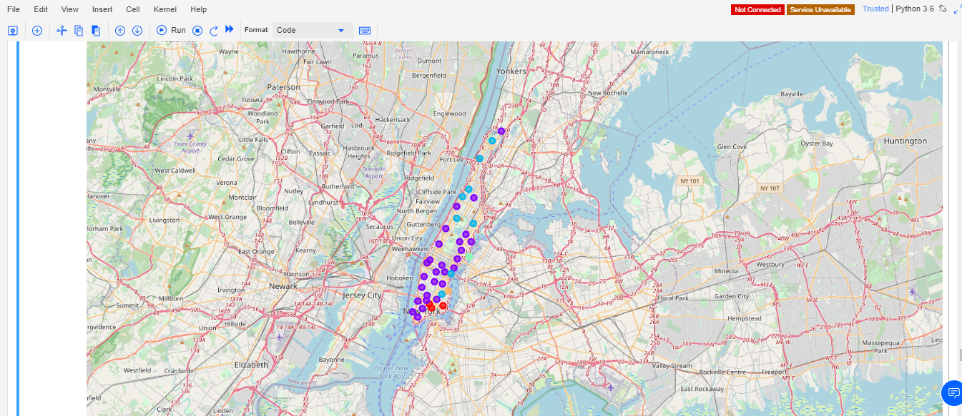
Plotting of the map

Slide 7
Description
The above figure displays the clusters which are plotted on the map of new york city.
Each cluster has the data and its own unique features which totally differ from each other. This clusters are close from one another and can be easily identified .
When we take cursor on the cluster its shows us the name of the cluster and when clicked takes us to the cluster containing the data and the features of the cluster.

Slide 8
One hot encoding
A one hot encoding is a representation of categorical variables as binary vectors.
This first requires that the categorical values be mapped to integer values.
Then, each integer value is represented as a binary vector that is all zero values except the index of the integer, which is marked with a 1.
The following figure shows the operation performed by us for the one hot encoding .

Slide 9
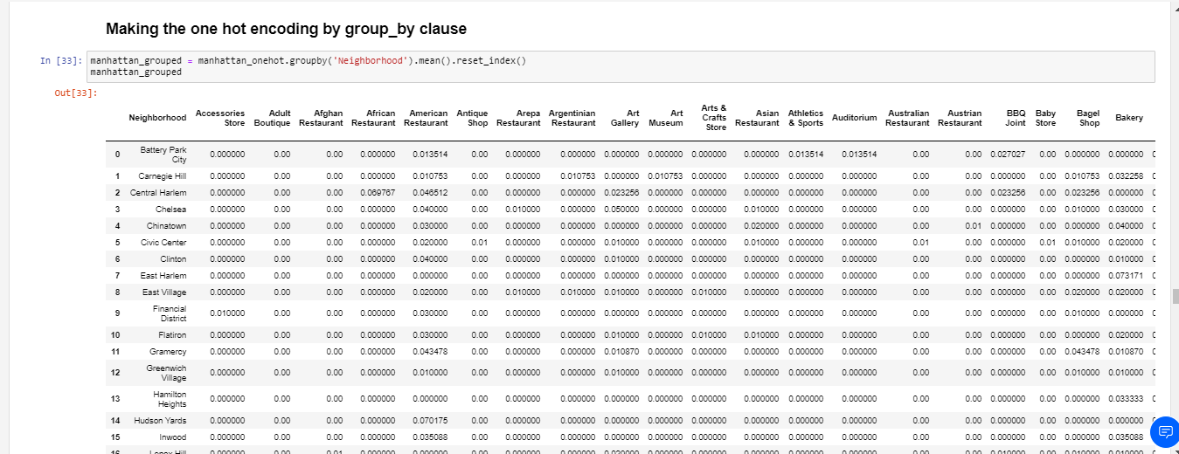
One hot encoding by clause

Slide 10
Conclusion and future direction
By the data analysis which we have performed we conclude that there are a number of clusters having different features which vary form each other. Each an every cluster has a different type of data set and contains different information of the city.
Future directions: In future we may try to implement many more features like nearby school or restaurants. Try to calculate the population of every cluster and predict a place for better living.

Slide 11
THANK you ….

